Slide 1
Listen to the Trees Talk:
Taking Notes, Writing and Speaking
Chapter 7

Slide 2

Listening to the Trees Talk
Reading, writing, and listening are important skills for college success. Learning to listen to the trees talk is a way to think about patience and understanding.
Trees can take many years to grow to a point that they have large trunks and branches filled with leaves. When the wind comes through and rustles the leaves, you can hear their song, but you must sit quietly, observe the wind, and listen patiently to the music.

Slide 3
These Are Related:
MEMORY
READING
NOTES

Slide 4

Why take notes?

Slide 5
Why take notes?
To remember

Slide 6
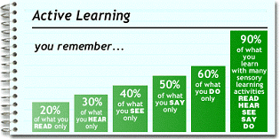
Be an active learner to remember as much as possible.

Slide 7


Over 50% of what we hear is lost in the first 20 minutes to an hour.

Slide 8

If your mind wanders, you can be here now by taking notes.

Slide 9
Handwritten Notes and Memory
Writing your notes by hand can improve memory because the brain is more active.
Writing notes by hand requires listening, processing, prioritizing, and summarizing the information in your own words.

Slide 10

Tips for taking notes
Be physically alert

Slide 11

Tips
Develop a positive attitude. Convince yourself that the speaker has something valuable to say.

Slide 12
Tips
Distinguish between listening and hearing.

Slide 13

Hearing is done with the ears.

Slide 14
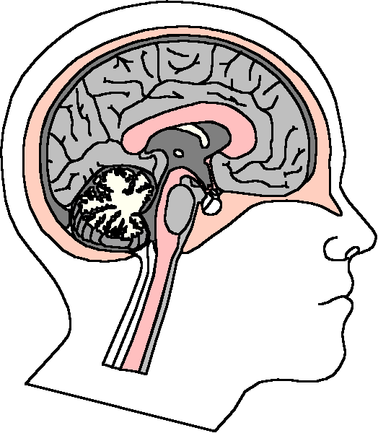
Listening is done with the mind.

Slide 15

Tips
STAY AWAKE!
Ask yourself questions
  Why is she saying that?
  What does he mean?
  What is the main point?

Slide 16

Tips
Take notes
The act of writing
keeps you physically
and mentally alert

Slide 17

Be open to different viewpoints and new ideas.

Slide 18

Prepare for note taking.

Slide 19
Have the proper materials.
Three ring binder
Notebook paper
Pen
Highlighter

Slide 20
Review the calendar and syllabus
What topic is being discussed?

Slide 21

Read the text
Find the main ideas
Be familiar with
the topic

Slide 22
What to write down
Focus on the main ideas.
Write supporting details as you have time.
Watch for verbal signals.

Slide 23

Signal words point the way.

Slide 24
Example Words
To illustrate
For example
For instance
Here comes an example. Write it down.

Slide 25
Addition Words
Here comes another main idea. Write it down too.
In addition
Also
Furthermore

Slide 26
Enumeration Words
The five steps
First, second, third
Next
Here comes a list. Organize your notes and write down the items in the list.

Slide 27
Time Words
Before, after
Formerly
Subsequently
Prior
Meanwhile
Hmm! Here comes a time relationship. What comes first and what happens next.

Slide 28
Cause and Effect Words
Therefore
As a result
If. . . .then
Here comes a cause and effect. Write the labels “cause” and “effect” in your notes and get these ideas in your notes.

Slide 29
Definition Words
In other words
It simply means
That is
In essence
Here comes a definition. Label it “def” and write down the definition. Test questions are often based on definitions.

Slide 30
Swivel Words
However
Nevertheless
Yes, but
Still
Here comes an exception or qualifying remark. Put this in your notes.

Slide 31
Compare and Contrast
Similarly
Likewise
In contrast
Write the similarities and differences in your notes.

Slide 32
Summary Words
In conclusion
To sum up
In a nutshell
Great! This is the end. I’ll try to write the summary word for word to make sure I have the most important ideas.

Slide 33
Test Words
This is important.
Remember this.
You’ll see this again
You might want to study this for the test.
This will be on the test. Make sure to know this.

Slide 34
Nonverbal Signals
Visually presented material
Handouts
Write down
whatever is
written on the
board

Slide 35



Note Taking Systems

Slide 36
The Cornell Format
2 1/2 inches
6 inches
RECALL
COLUMN
TAKE NOTES HERE
INDENT FOR MINOR
POINTS
MAJOR POINTS
QUESTIONS
OUTLINE

Slide 37
Practice: Taking Notes in the Cornell Format

Slide 38
Create a Mind Map
Check
Syllabus
Read
Review
Be here now
Note taking
Develop An
Interest
Record

Slide 39
Taking Notes in Math
Pre-read the chapter before the lecture so that you can become familiar with the concepts.
As you read, write some questions in the margin so you can ask them in class if needed.

Slide 40
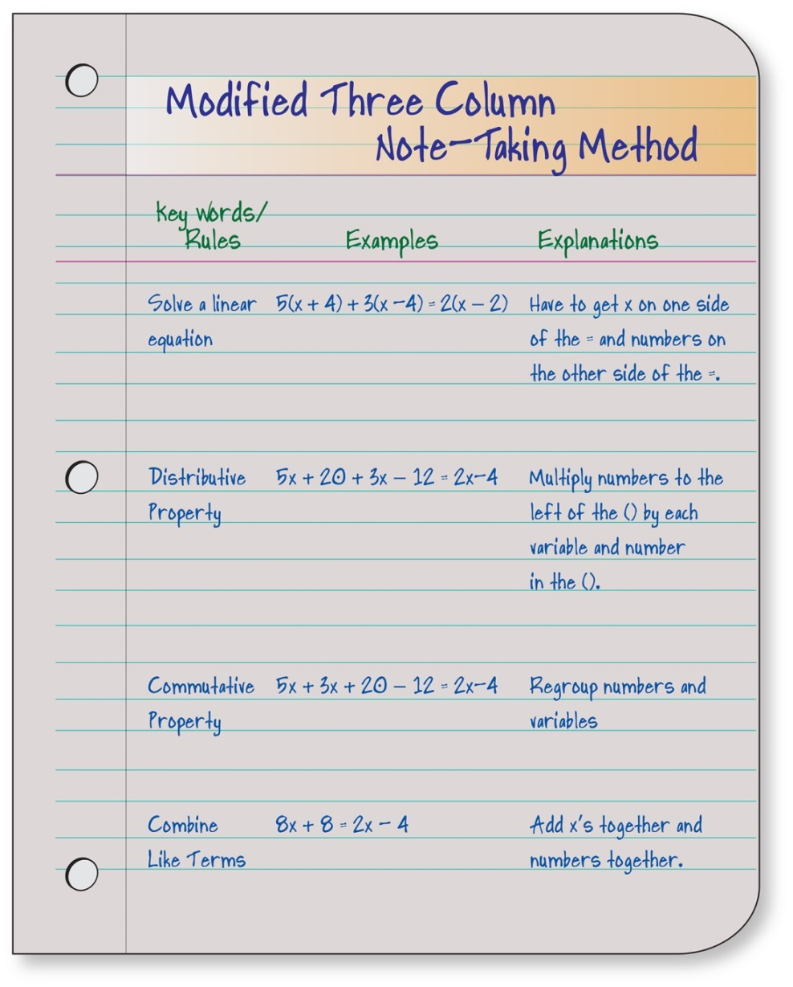
Three Column Note-Taking Method

Slide 41
Practice: Taking Notes with a Mind Map.

Slide 42
Research notes
Notes for writing papers and speeches
Use 3x5 cards
Source cards
Information cards
Use your own words
3x5 card

Slide 43

Review Your Notes

Slide 44

Remember that it is most effective to review within 20 minutes.

Slide 45

How to Review

Slide 46
Highlight or underline the main points. Fill in missing details.

Slide 47
If using the Cornell Format, use the recall column to test yourself.

Slide 48
Group Activity:
A Case Study

Slide 49
Assignment:
Note Taking Checklist
Evaluate Your Note Taking
Skills

Slide 50
Writing

Slide 51
Power Writing
Prepare
Organize
Write
Edit
Revise

Slide 52
Prepare

Slide 53
Plan Your Time
Avoid stress by planning ahead.
Allow time for life’s emergencies and computer problems.

Slide 54
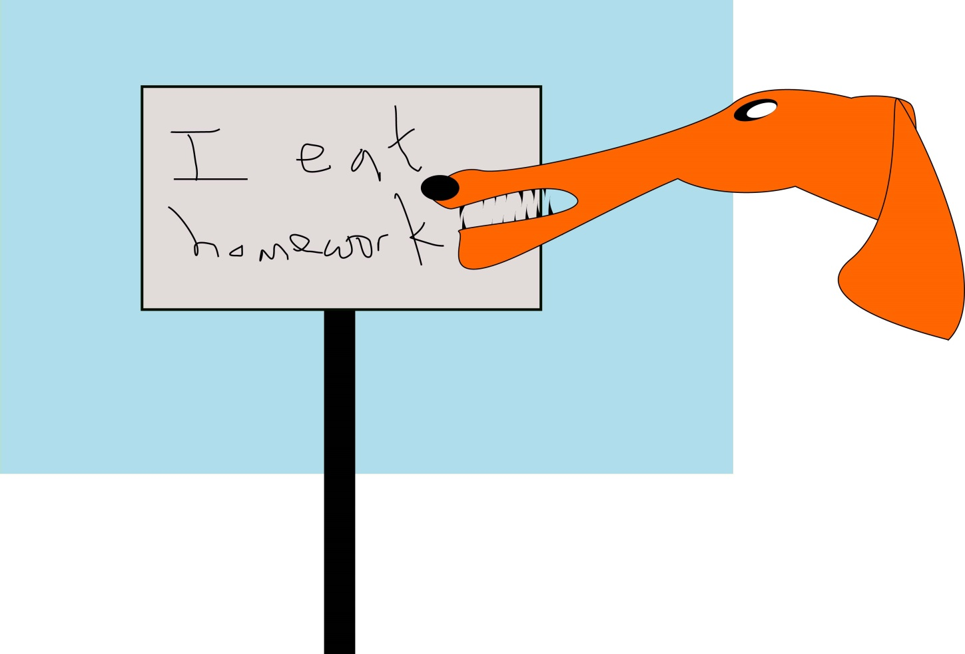
Professors have heard all the excuses!

Slide 55
Find a Space and Time

Slide 56

Choose a General Topic

Slide 57

Gather Information

Slide 58

Write a Thesis Statement
The key idea
  What is the most important idea?
  What question would I like to ask about it?
  What is my answer?

Slide 59

Organize
List topics
Arrange in a logical order

Slide 60
Write

Slide 61

Get Started
Write freely.
Use brainstorming.
if you are stuck.
Write the first sentence.
Write the introduction.
Write a first draft.
Break it into small parts.
Beware of procrastination.

Slide 62
Exercise: Free Writing

Slide 63
Writing a paper is like climbing a mountain. What small steps can you take to get started?

Slide 64



Save Your Work
On your hard drive
On a flash drive
A written copy

Slide 65
The Introduction
Contains the thesis statement
Foundation for the paper
Contains interesting points that motivate the reader to read your paper

Slide 66
The Body of the Paper
Good writing is clear thinking.
Use plain and understandable language.
Provide explanation and examples.

Slide 67

Beware of Plagiarism
Copying the work of others without giving them credit

Slide 68
Avoid Plagiarism by:
Using quotations and providing a reference
Thinking about the main ideas and then looking away and writing them in your own words

Slide 69
Write a Conclusion
Summarizes topics
Answers question posed in the thesis statement
Make it interesting and powerful

Slide 70

Include References
Author
Title of book
Publisher of book
City where the book was published
The publication date
The page number

Slide 71



Use an Appropriate Style
APA
Chicago Style
MLA

Slide 72
Example of APA Style:
Fralick, M. College and career success, ninth ed., Dubuque: Kendall/Hunt Publishing Company, 2021, p. 99.

Slide 73
Write your first draft and put it away for awhile. Why?

Slide 74

Edit and Revise
Read it. Does it make sense?
Check grammar and spelling.
Be courageous and select the best.
Check for biased language.

Slide 75
Biased Language Examples
Policeman
Chairman
Fireman
Mailman
Mankind
Lady
Police Officer
Chair
Fire Fighter
Mail Carrier
Humanity
Woman

Slide 76
Prepare the Final Copy
Double space
Font of 10 or l2
One inch margins on sides
Three inch top margin on first page
Don’t forget Bibliography or Works Cited
Number your pages

Slide 77
The Bibliography or Works Cited
Title of Publication
Author
Publisher
Date
Page number
See text for sample

Slide 78
Term Paper Exercise
I am assigning a term paper that is due in eight weeks. You have to read 4 books, 3 magazines, and view one film. Please give me a detailed plan of how you will complete this assignment using the POWER strategy explained in the chapter.

Slide 79

Making An Oral Presentation

Slide 80

Relax!

Slide 81

Some Relaxation Techniques
Admit you are anxious.
You do not have to be perfect.
Take deep breaths and focus on your breathing.
Use positive self-talk.

Slide 82
Parts of a Speech
The Introduction
The Main Body
The Conclusion

Slide 83
Making a Speech
Practice your speech until you feel comfortable.
Review the set-up.
Deliver the speech.
  Dress appropriately and comfortably.
  Remember to smile and make eye contact.
  Don’t forget your sense of humor.

Slide 84

Make a Speech
Take an item out of your purse or wallet. Make a 30 second speech about that item.
(No cell phone, keys, or credit cards)
Include: Intro
Body
Conclusion

Slide 85
The College Success Web site has many resources on making a speech:
Toast Masters
Virtual Assistant
Examples of Best Speeches in History
Public Speaking Web Site
www.collegesuccess1.com

Slide 86
Keys to Success:
Be Selective

Slide 87
How to be selective?

Slide 88
If you focus on the details first, you will get lost.

Slide 89
Grouping the details under general ideas will help you to remember them.

Slide 90
It’s Like Putting a Puzzle Together
What does the picture look like?
Then put the pieces together

Slide 91
To Be Selective
Start with the general idea.
Then focus on the details.

Slide 92
The Essence of Genius is Knowing What to Overlook.
William James

Slide 93
To Get the General Idea:
Be a Genius
Survey the chapter.
Listen for the main points in the lecture.
Mark 20% of the text.
In your personal life, focus on your priorities.

Slide 94
Stories from the Elders
How the Spider Symbol Came to the People
What did you learn from this story?

